Slide 1


Ching Lam Chan
2/8/2024

Slide 2

Outline
Executive Summary
Introduction
Methodology
Results
Conclusion
Appendix

Slide 3
Executive Summary
Summary of methodologies
Data collection
Data wrangling
Exploratory data analysis with data visualisation
Exploratory data analysis with data SQL
Interactive visual analytics and dashboard with Folium
Predictive analysis
Summary of all results
Exploratory data analysis results
Interactive analytics demo in screenshots
Predictive analysis results

Slide 4
Introduction
Project background and context
SpaceX's Falcon 9 rocket has transformed the space launch industry through its innovative reusable first-stage booster, significantly lowering launch costs to $62 million compared to over $165 million from other providers. The ability to reuse the first stage is a key factor in these savings, as evidenced by the successful landing and recovery of the first stage on numerous occasions. Predicting the success of these landings is crucial for accurately estimating launch costs, which is valuable information for any company looking to compete with SpaceX. By analyzing the factors that influence landing success, we can enhance our understanding of launch economics and provide insights for potential competitors in the space launch market.
Problems you want to find answers
What are the critical factors influencing the successful landing of the Falcon 9 first stage?
How do specific rocket variables and their relationships impact the probability of a successful landing?
What optimal conditions should SpaceX aim for to maximize the success rate of first-stage landings?

Slide 5

Section 1

Slide 6
Methodology
Executive Summary
Data collection methodology:
Data was gathered through the SpaceX API and by web scraping information from Wikipedia
Perform data wrangling
Categorical variables were transformed using one-hot encoding
Perform exploratory data analysis (EDA) using visualization and SQL
Including scatterplot and bargraphs
Perform interactive visual analytics using Folium and Plotly Dash
Perform predictive analysis using classification models
How to build, tune, evaluate classification models

Slide 7
Data Collection
Data acquisition involved two main methods:
SpaceX API:
We sent GET requests to the SpaceX API
JSON responses were decoded using the .json() method
We then converted the JSON data into a pandas DataFrame using json_normalize()
The resulting DataFrame underwent cleaning, including checks for missing values and appropriate data imputation where needed
Web Scraping:
We utilized BeautifulSoup to scrape Falcon 9 launch records from Wikipedia
The process involved extracting HTML tables containing launch information
These tables were then parsed and transformed into pandas DataFrames
The ultimate goal of this data collection process was to create comprehensive and clean datasets for subsequent analysis of SpaceX launches, particularly focusing on Falcon 9 missions.

Slide 8
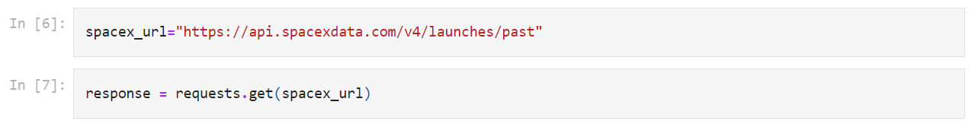
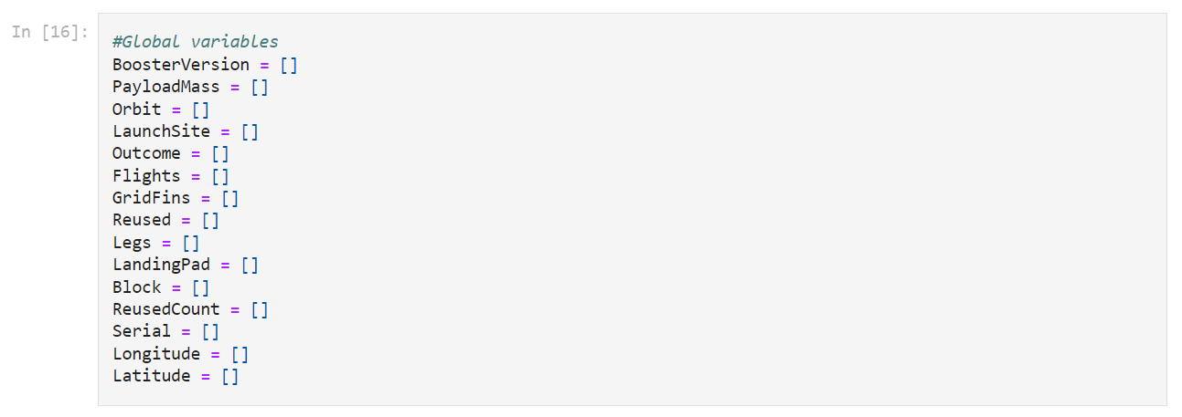
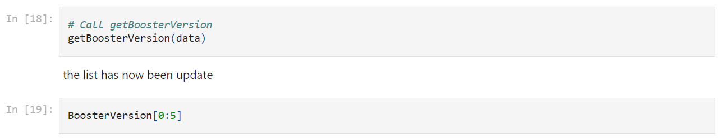
Data Collection – SpaceX API
Utilized GET requests to the SpaceX API to gather data
Converted response to a .JSON file
Cleaned data
Filtered dataframe
Exported to .CSV file
please see: https://github.com/karenccl/SpaceX-Falcon-9-first-stage-Landing-Prediction/blob/main/jupyter-labs-webscraping.ipynb

Slide 9
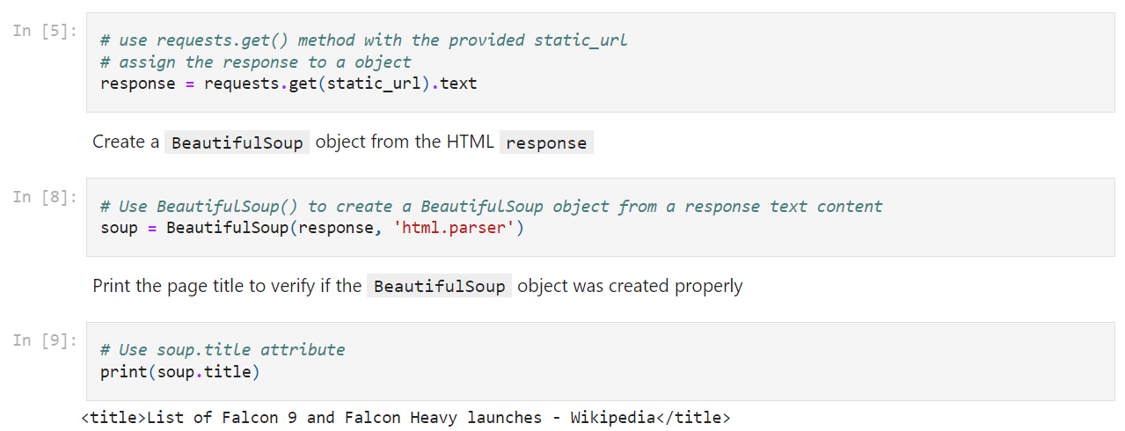
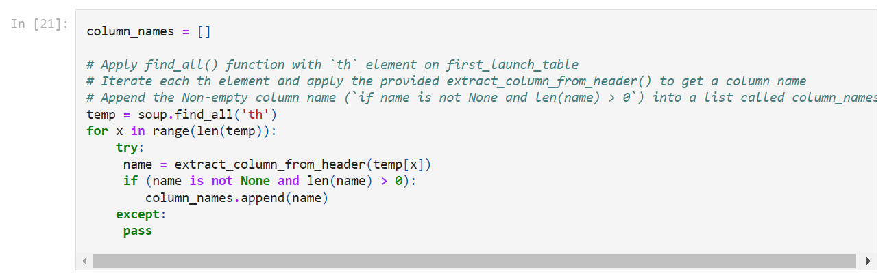
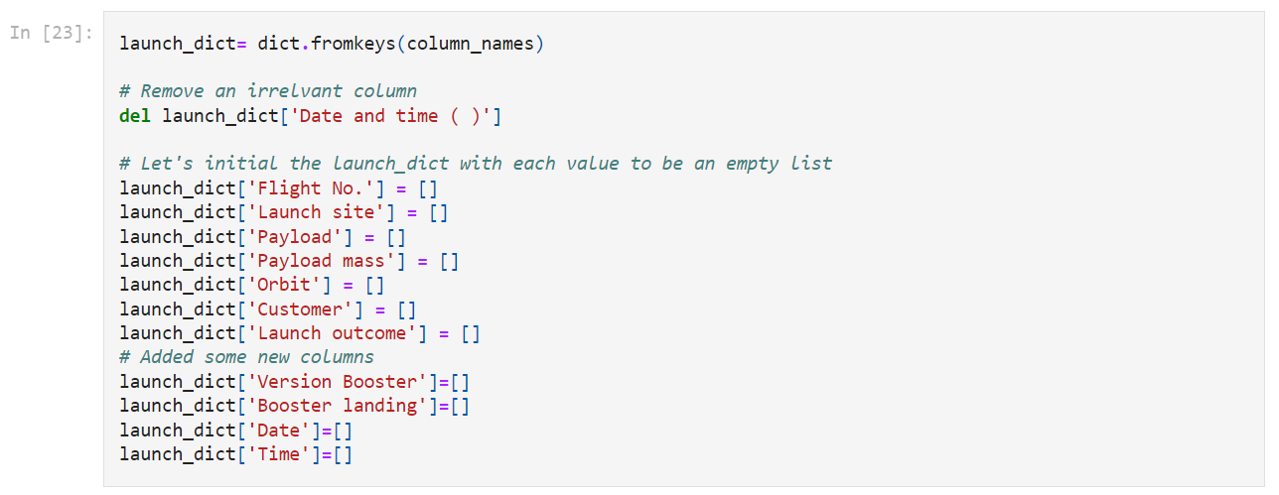
Data Collection - Scraping
Retrieved HTML Content
Parsed HTML with BeautifulSoup
Located Relevant Tables
Extracted Column Headers
Initialized a Data Dictionary
Populated the Dictionary
Converted to DataFrame
Exported to CSV
Please see: https://github.com/karenccl/SpaceX-Falcon-9-first-stage-Landing-Prediction/blob/main/jupyter-labs-webscraping.ipynb

Slide 10
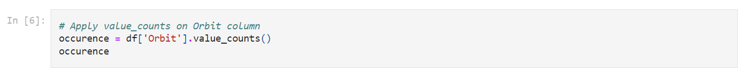
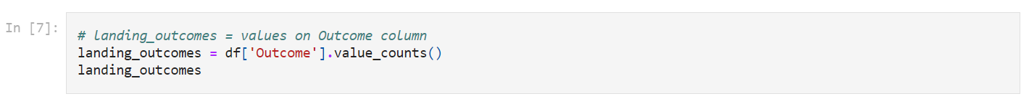
Data Wrangling
Determine the Launch Count per Site
Calculate the total number of launches conducted at each launch site
Assess Orbit Frequency
Calculate the frequency and count of each orbit type
Analyze Mission Outcomes by Orbit Type
Calculate the number and frequency of mission outcomes for each orbit type
Generate Landing Outcome Labels
Create a new label for landing outcomes based on the data in the Outcome column
Please see: https://github.com/karenccl/SpaceX-Falcon-9-first-stage-Landing-Prediction/blob/main/labs-jupyter-spacex-Data%20wrangling.ipynb

Slide 11
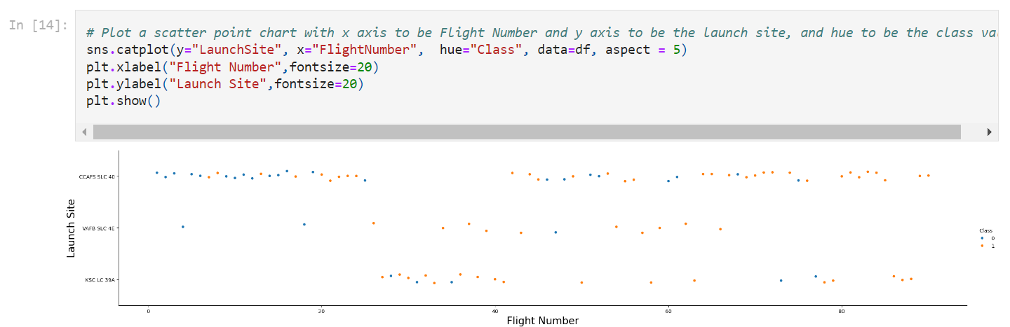
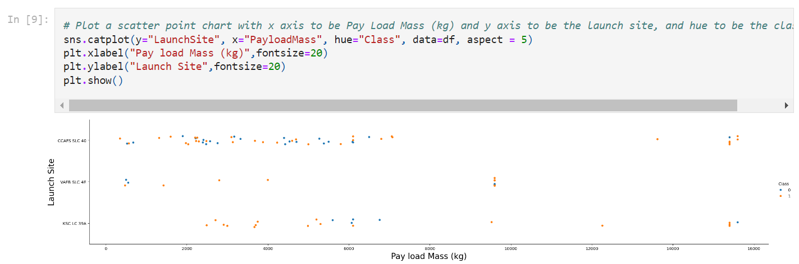
EDA with Data Visualization
Data visualization:
Flight Number vs. Payload Mass
Flight Number and Launch Site Relationship
Payload and Launch Site Relationship
Success Rate by Orbit Type
Flight Number and Orbit Type Correlation
Payload Mass and Orbit Type Correlation
Annual Launch Success Trend
Please see: https://github.com/karenccl/SpaceX-Falcon-9-first-stage-Landing-Prediction/blob/main/edadataviz.ipynb

Slide 12
EDA with SQL
Retrieve and display the names of all unique launch sites involved in the space missions.
Display 5 records where the launch site names begin with the string 'CCA'.
Calculate and display the total payload mass carried by boosters launched by NASA (CRS).
Compute and display the average payload mass carried by the booster version F9 v1.1.
List the date when the first successful landing outcome on a ground pad was achieved.
List the names of boosters that have successfully landed on a drone ship and carried a payload mass between 4000 and 6000 kg.
Display the total count of successful and failed mission outcomes.
List the names of booster versions that have carried the maximum payload mass. Use a subquery for this task.
Display records showing the month names, failed landing outcomes on drone ships, booster versions, and launch sites for the months in the year 2015.
Rank the count of successful landing outcomes between the dates 04-06-2010 and 20-03-2017 in descending order.
Please see: https://github.com/karenccl/SpaceX-Falcon-9-first-stage-Landing-Prediction/blob/main/jupyter-labs-eda-sql-coursera_sqllite%20(1).ipynb

Slide 13
Build an Interactive Map with Folium
Map All Launch Sites
Plot the locations of all SpaceX launch sites on a geographical map.
Use appropriate markers or icons to represent each launch site.
Visualize Launch Outcomes by Site
On the same map, differentiate between successful and failed launches for each site.
Use color-coding or different markers to represent success and failure.
For example, green markers for successful launches and red for failed ones.
Calculate Proximity Distances
For each launch site, calculate distances to nearby points of interest or critical locations.
Create a Distance Analysis
Compile the calculated distances into a table or dataset.
Consider creating a visualization (e.g., bar chart or heat map) to represent these distances graphically.
Analyze Geographical Factors
Use the map and distance data to analyze how geographical factors might correlate with launch success rates.
Please see: https://github.com/karenccl/SpaceX-Falcon-9-first-stage-Landing-Prediction/blob/main/lab_jupyter_launch_site_location.ipynb

Slide 14
Build a Dashboard with Plotly Dash
Continuous Availability
Hosted on Python Anywhere for 24/7 accessibility
Built using Flask and Dash web frameworks
Visualizations
Pie Chart: Total Launches by Site
Scatter Graph: Outcome vs. Payload Mass
Interactive Elements
Users can manipulate data views and explore different aspects of launches
Please see: https://github.com/karenccl/SpaceX-Falcon-9-first-stage-Landing-Prediction/blob/main/space_dash.py

Slide 15
Predictive Analysis (Classification)
Data Loading
Import the dataset into NumPy and Pandas for efficient manipulation
Data Transformation
Preprocess and clean the data as necessary
Perform feature engineering
Data Splitting
Divide the dataset into training and test sets
Verify the number of samples in the test set
Algorithm Selection
Evaluate and choose appropriate machine learning algorithms for the task
Hyperparameter Tuning Setup
Define parameter grids for each selected algorithm
Set up GridSearchCV objects with chosen parameters and algorithms
Model Training
Fit the training data to the GridSearchCV objects
This process will train models with various hyperparameter combinations
Model Evaluation
Assess model performance using the test set
Compare results across different algorithms and parameter settings
Final Model Selection
Choose the best performing model based on evaluation metrics
Please see: https://github.com/karenccl/SpaceX-Falcon-9-first-stage-Landing-Prediction/blob/main/SpaceX_Machine%20Learning%20Prediction_Part_5.ipynb

Slide 16

Section 2

Slide 17
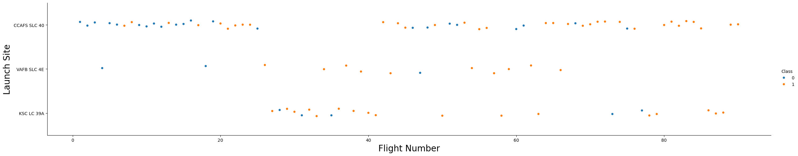
Flight Number vs. Launch Site
A higher number of flights at a launch site is associated with an increased success rate at that site

Slide 18
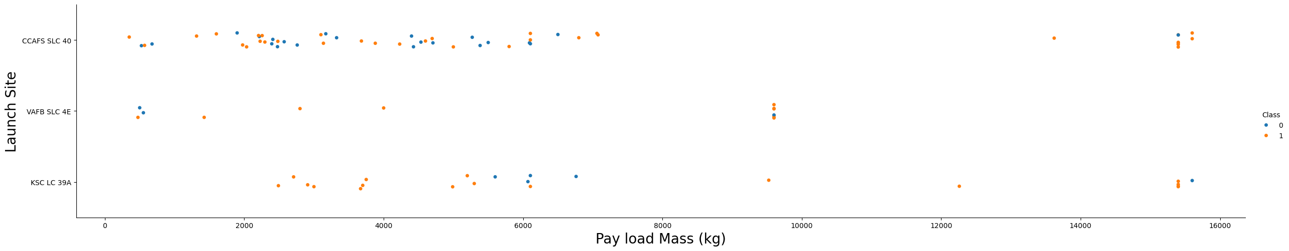
Payload vs. Launch Site
The greater the payload mass for launch site CCAFS SLC 40, the higher the success rate for the rocket

Slide 19
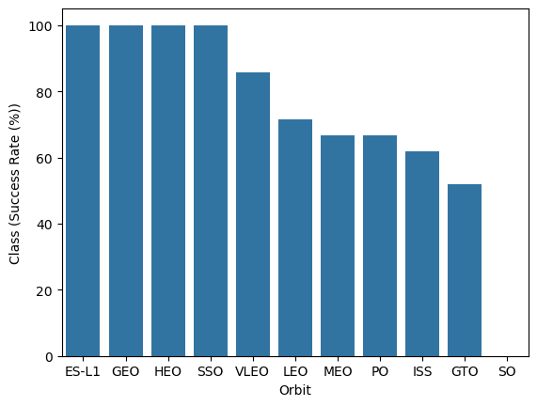
Success Rate vs. Orbit Type
ES-L1, GEO, HEO, SSO had the most success rate

Slide 20
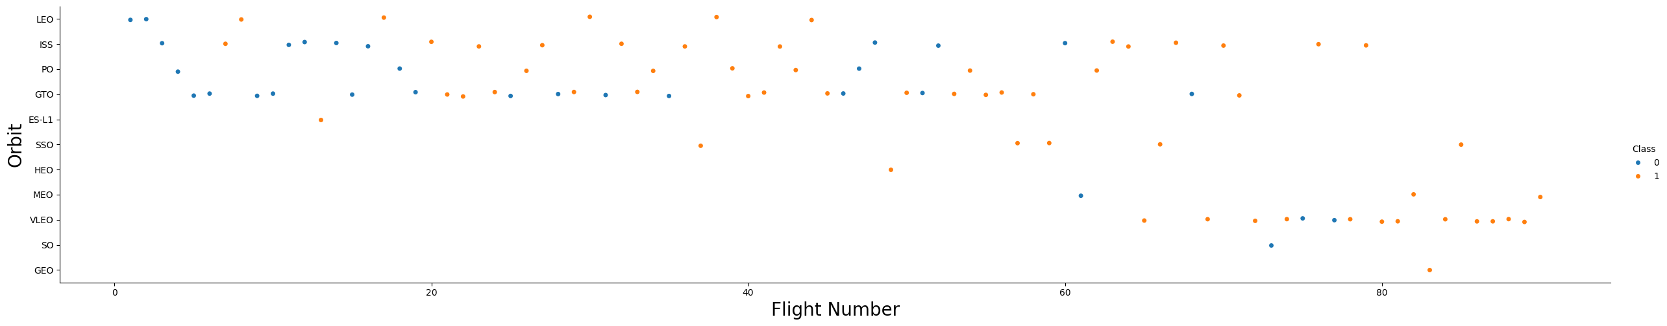
Flight Number vs. Orbit Type
The LEO orbit’s success is related to the number of flights whereas in the GTO orbit, there is no relationship between flight number and the orbit

Slide 21
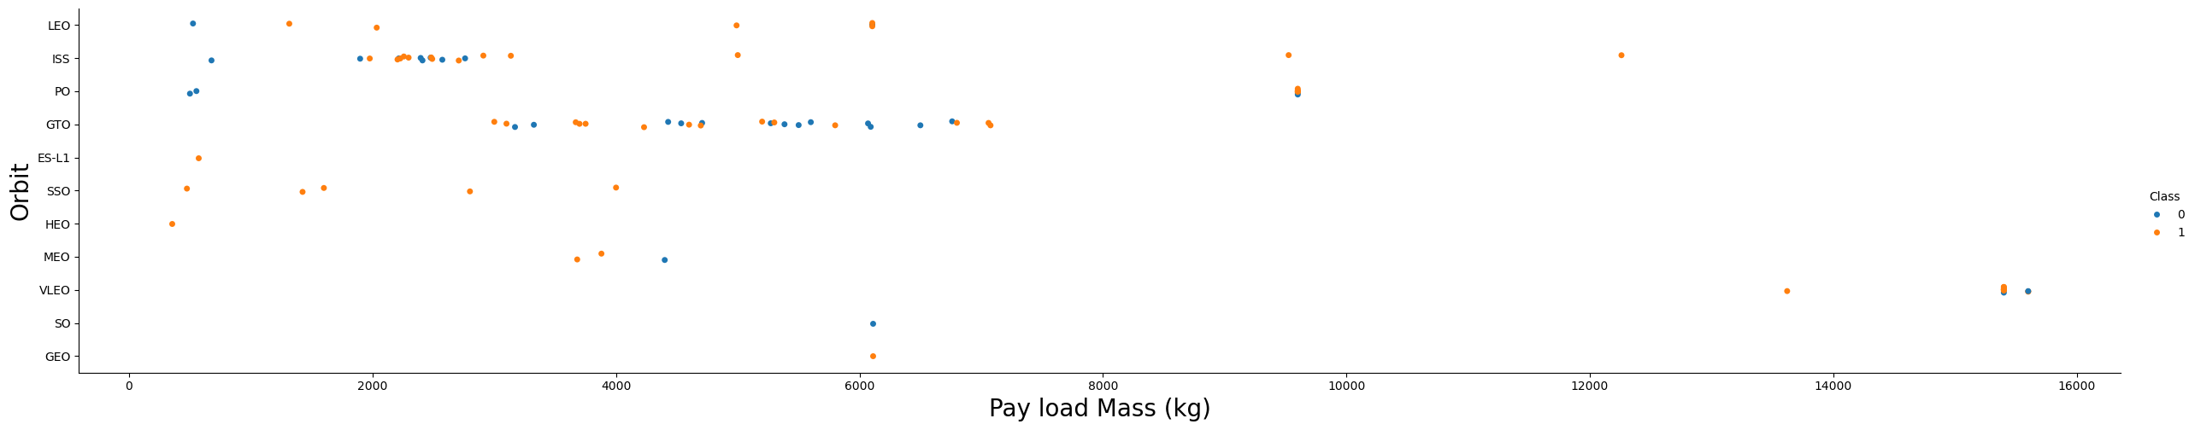
Payload vs. Orbit Type
Heavy payloads are more likely to achieve successful landings PO, LEO, and ISS orbit.

Slide 22
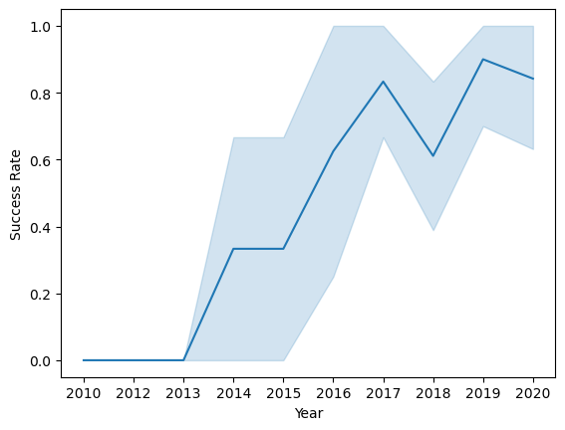
Launch Success Yearly Trend
The success rate has consistently increased from 2013 to 2020

Slide 23
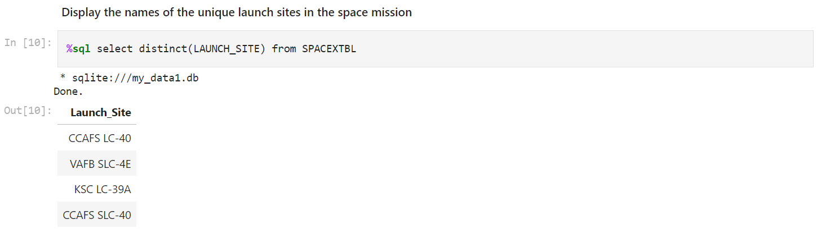
All Launch Site Names
Names of the unique launch sites:
CCAFS LC-40
VAFB SLC-4E
KSC LC-39A
CCAFS SLC-40

Slide 24
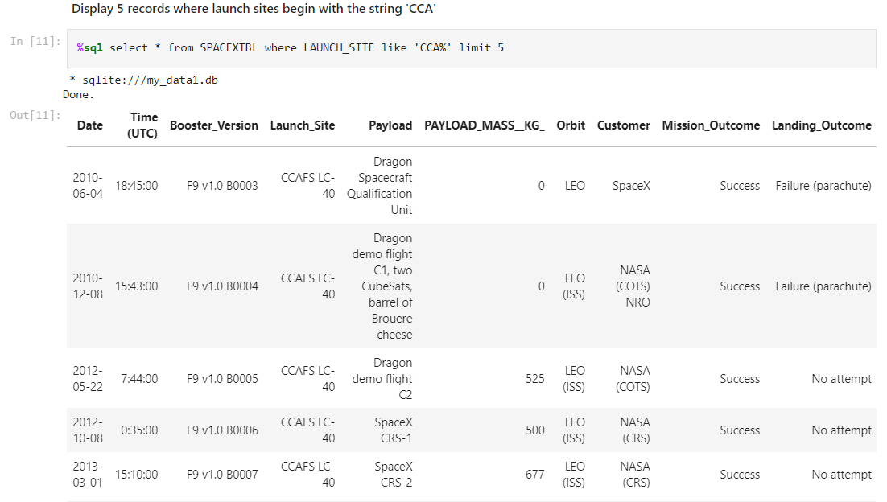
Launch Site Names Begin with 'CCA'
5 records where launch sites begin with `CCA`

Slide 25
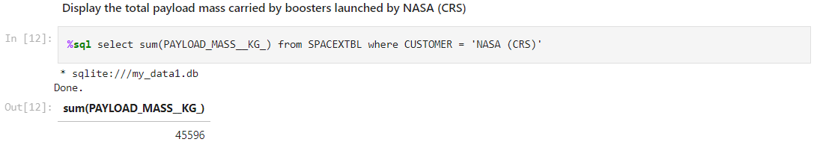
Total Payload Mass
Total payload carried by boosters from NASA: 45596 kg

Slide 26
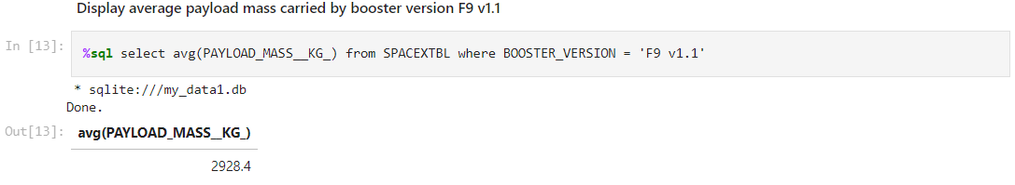
Average Payload Mass by F9 v1.1
Average payload mass carried by booster version F9 v1.1: 2928.4 kg

Slide 27
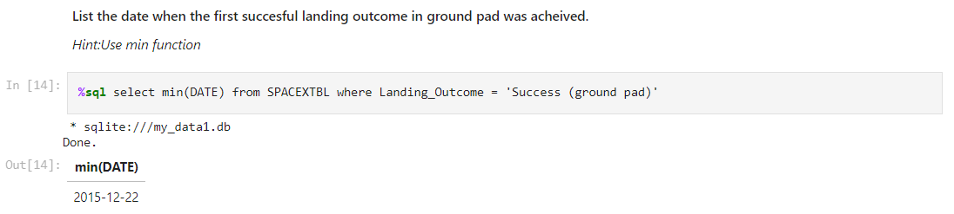
First Successful Ground Landing Date
Date of the first successful landing outcome on ground pad: 2015/12/22

Slide 28
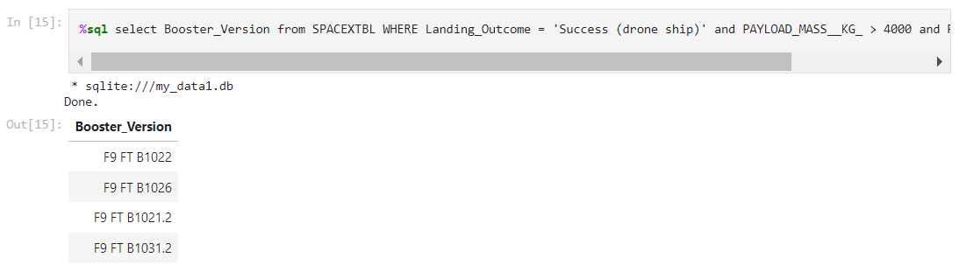
Successful Drone Ship Landing with Payload between 4000 and 6000
Names of boosters which have successfully landed on drone ship and had payload mass greater than 4000 but less than 6000:
F9 FT B1022
F9 FT B1026
F9 FT B1021.2
F9 FT B1031.2

Slide 29
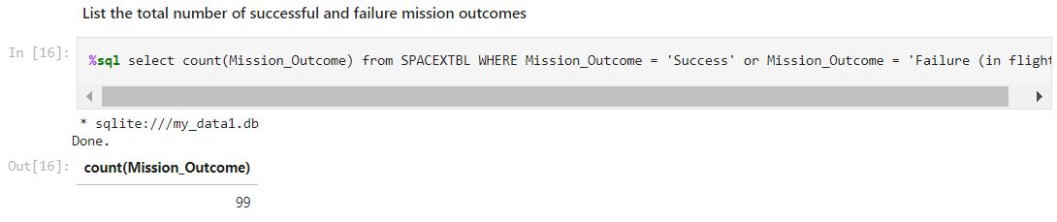
Total Number of Successful and Failure Mission Outcomes
Total number of successful and failure mission outcomes: 99

Slide 30
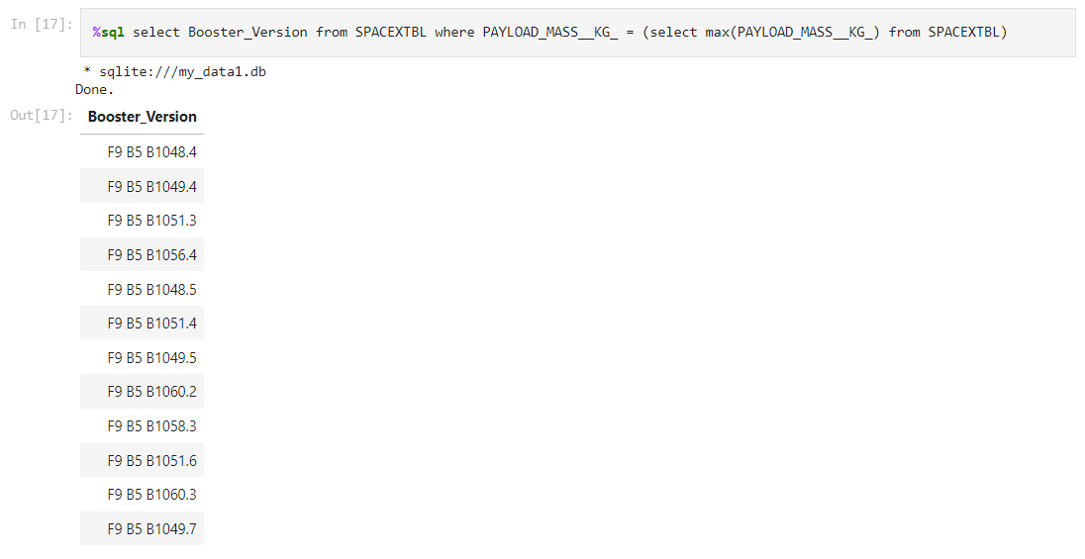
Boosters Carried Maximum Payload
Names of the booster which have carried the maximum payload mass

Slide 31
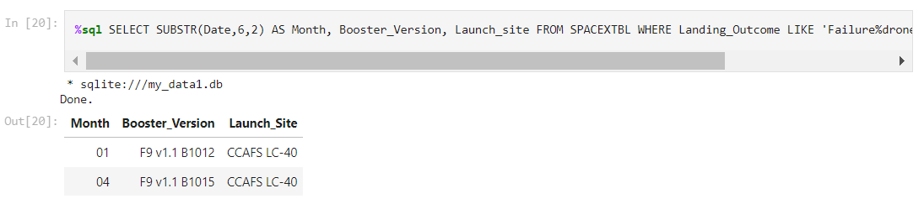
2015 Launch Records
List the failed landing_outcomes in drone ship, their booster versions, and launch site names for in year 2015

Slide 32
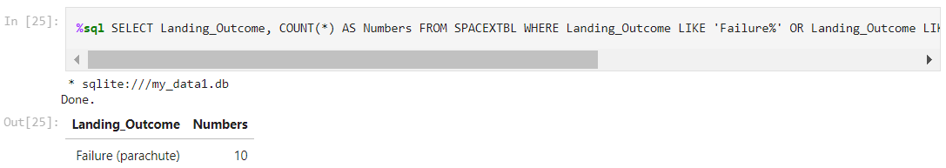
Rank Landing Outcomes Between 2010-06-04 and 2017-03-20
Count of landing outcomes (such as Failure (drone ship) or Success (ground pad)) between the date 2010-06-04 and 2017-03-20, in descending order

Slide 33

Section 3

Slide 34
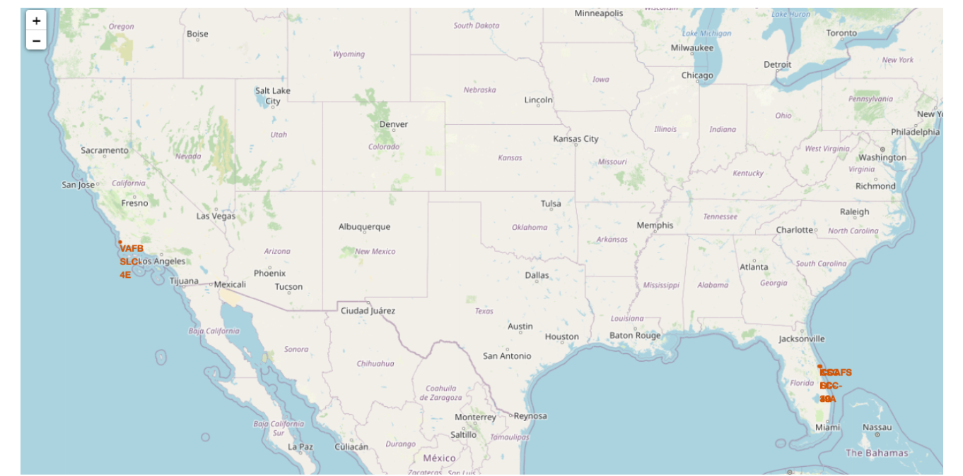
All Launch Sites Global Map Markers
SpaceX launch sites are in the United States of America coasts
Florida and California

Slide 35
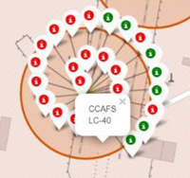
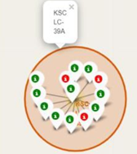
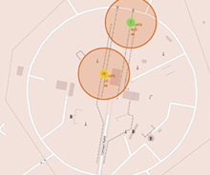
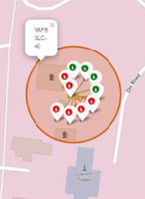
Markers Showing Launch Sites With Color Labels
Green Marker shows successful Launches
Red Marker shows Failures

Slide 36
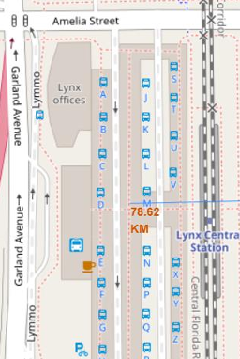
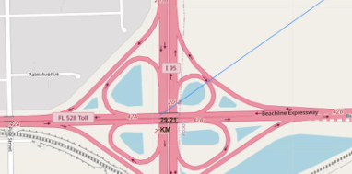
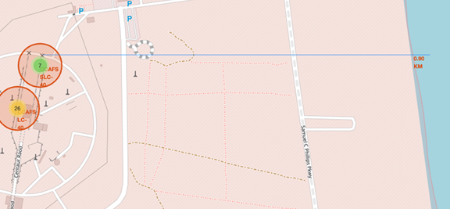
Launch Site Distance To Landmarks
Railways and Highways: Not in close proximity
Coastline: Close proximity observed
Cities: Maintained at a distance

Slide 37

Section 4

Slide 38
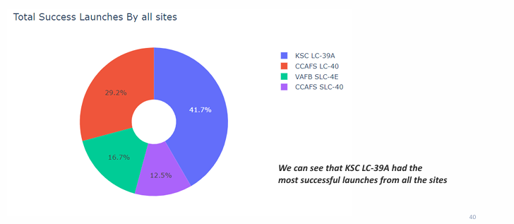
Pie Chart Showing The Success Percentage Achieved By Each Launch Site
KSC LC-39A had the highest total success launches

Slide 39
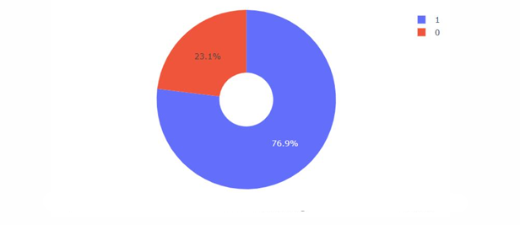
Pie Chart Showing The Launch Site With The Highest Launch Success Ratio
KSC LC-39A had a 76.9% success rate and a 23.1% failure rate

Slide 40
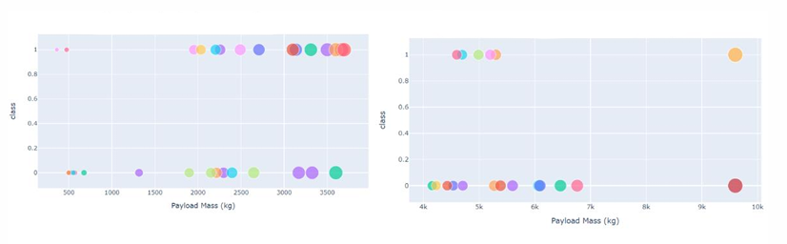
Scatter Plot Of Payload Vs Launch Outcome For All Sites, With Different Payload Selected In The Range Slider
The success rates for lighter payloads are higher than those for heavier payloads

Slide 41

Section 5

Slide 42
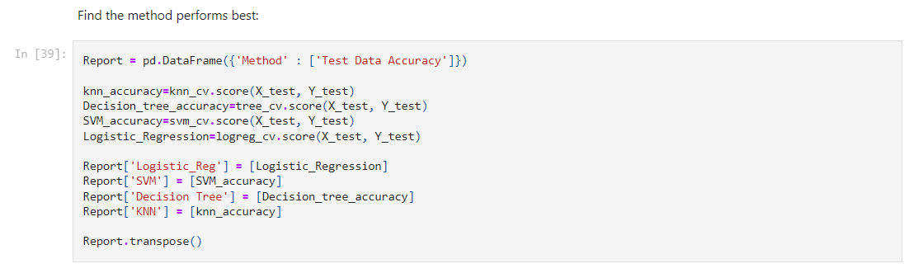
Classification Accuracy
0.8333333333333334
The Tree Classifier Algorithm is the best for machine learning for this dataset

Slide 43
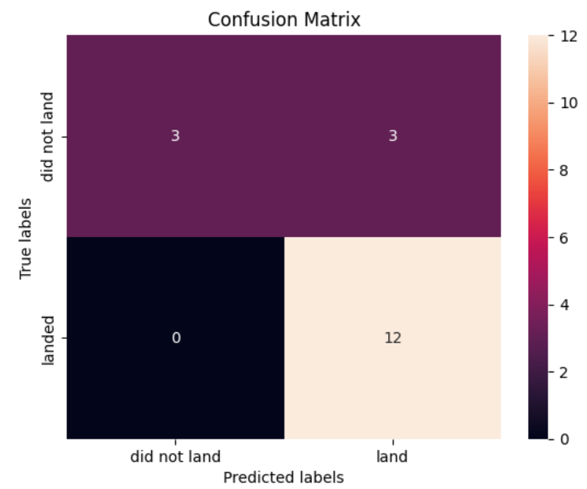
Confusion Matrix

Slide 44
Conclusions
SpaceX Launch Data Analysis Insights
Model Performance
The Tree Classifier Algorithm proved most effective for this dataset
Achieved a high accuracy of 84% using optimized parameters
Payload Impact
Lighter payloads generally showed better performance than heavier ones
Increased payload mass correlates with lower first stage return success
Launch Success Trends
SpaceX's launch success rate shows a positive correlation with time
Continuous improvement observed, indicating ongoing refinement of launch processes
Launch Site Performance
KSC LC-39A emerged as the most successful launch site
Orbit Type Success Rates
Highest success rates: GEO, HEO, SSO, and ES-L1 orbits
Lowest success rate: SO (Sub-Orbital) launches
Site-Success Correlation
Clear relationship between launch sites and success rates
Suggests some sites may offer more favorable launch conditions
Temporal Trends
Marked increase in success rates from 2013 to 2020
Indicates significant technological and operational improvements over time

Slide 45


